Slide 1
Starter
How many words can you make out of the letters in:
chronological
e.g. corn, logic, lag…
Learning Objective: To recall events chronologically.

Slide 2
Half Term Reading Check
Over half term you read Chapters 15 – 21.
Task: Each table will work to summarise their given chapter of the book. You must create a poster on sugar paper, which will include:
The key events of the chapter
Any themes encountered
Characters in the chapter
Important questions raised or answered
What happens in the chapter before and after (briefly)
Be prepared: you will have two minutes to present your poster/handout to the class at the end of the lesson.

Slide 3
Please stick yesterday’s grid (Title: Half term reading) and your lotus diagram into your books.
Starter
between the relationships consider to characters.
Unscramble our learning objective
To consider the relationships between characters.

Slide 4
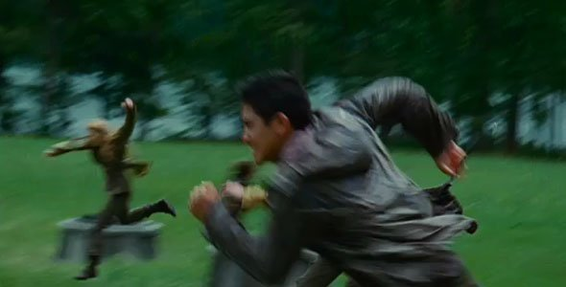
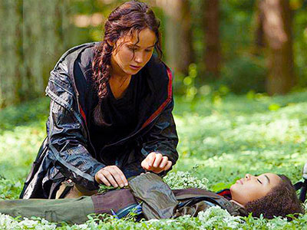
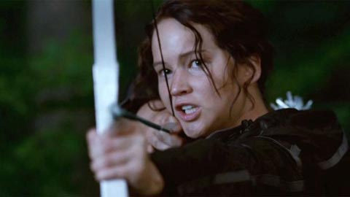

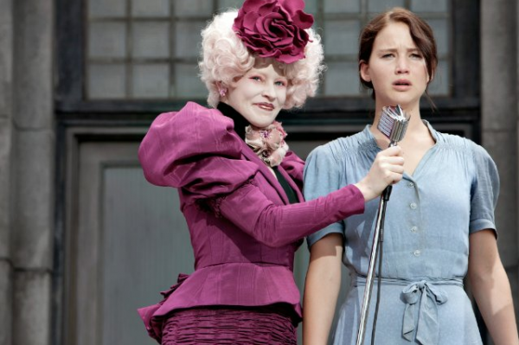
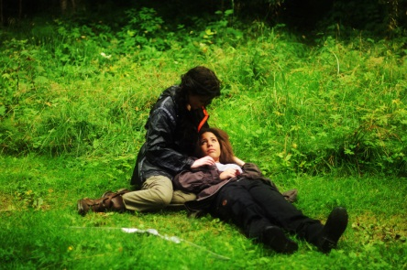
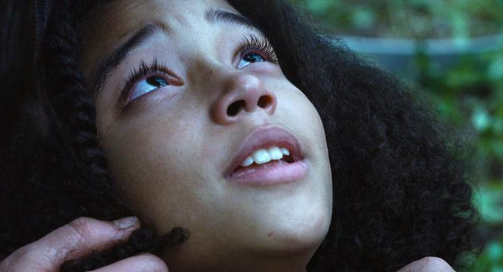
Task: Create a table, listing examples of times when human kindness vs. human savagery are shown in the book.
Human Kindness
Vs.
Human Savagery

Slide 5
Table discussion…Numbered Heads feedback
“Everything's still and quiet. Then, almost eerily, the mockingjays take up my song. For a moment, I sit there, watching my tears drip down on her face. Rue’s cannon fires…
I can’t stop looking at Rue, smaller than ever, a baby animal curled up in a nest of netting. I cant bring myself to leave her like this. Past harm, but seeming utterly defenceless. To hate the boy from District 1, who also appears so vulnerable in death, seems inadequate. It’s the Capitol I hate, for doing this to all of us.” – p. 275
Katniss sings Rue a song about ‘promising tomorrow will be more hopeful than today’. What is significant about the mockingjays taking up the song?
What word emphasises Rue’s vulnerability? Why is this vulnerability important ?
Why does Katniss describe Rue as ‘a baby animal curled up in a nest of netting’? What does it suggest about life in The Hunger Games?
Why does Katniss turn her hatred towards the Capitol? How does this help make her a heroic figure?

Slide 6
Table discussion…Numbered Heads feedback
Why does Katniss decide to decorate Rue’s body? How does this make her heroic?
“A few steps into the woods grows a bank of wild flowers. Perhaps they are really weeds of some sort, but they have blossoms in beautiful shades of violet and yellow and white. I gather up an armful and come back to Rue’s side. Slowly, one stem at a time, I decorate her body in the flowers. Covering the ugly wound. Wreathing her face. Weaving her hair with bright colours.
They’ll have to show it. Or, even if they choose to turn the cameras elsewhere at this moment, they’ll have to bring them back when they collect the bodies and everyone will see her then and know I did it.” - p. 276
What do flowers symbolise? What about the colours of the flowers?
Why would this be considered an act of defiance against the Capitol?
Why is it important to Katniss that other people are able to see what she is doing?

Slide 7
Learning objective: To consider the relationships between characters.
Plenary:
What do you think Suzanne Collins wants her readers to learn from Katniss and Rue’s relationship?
“Don’t hate the playa, hate the game y’all!”
Why not keep Rue alive?
Notes:
Final discussion if time, then short written response? Add Rue to flowers page/humanity?

